Slide 1
Sentiment Analysis of Social Media Tweets Using Leading Economic Indicators of Recession
Masters project for
the Master of Science in Data Science degree in
the College of Arts and Sciences of Lewis University

Slide 2
Introduction
President Donald Trump’s daily tweets on Twitter from January 20, 2017 to January 31, 2018
How can they influence daily changes in the economic markets of the U.S. Economy?
Can a tweet with negative sentiment cause a change in the direction of expansion?
Can a tweet with positive sentiment cause a change in the direction of contraction?
Are the specific words used in the tweets important to influence the daily change?
A sentiment analysis label
Positive, Neutral, or Negative Polarity
A leading economic indicator of recession label
Expansion
Contraction

Slide 3

Leading Economic Indicators of Recession
Copper-Gold Ratio
When the economy is expanding copper prices rise.
When the economy is contracting gold prices rise.
An increase means the economy is expanding and a decrease means it is contracting.
Copper-Gold Ratio = $\frac{Copper}{Gold}$

Slide 4
Leading Economic Indicators of Recession
Yield Curve Flattening
During an expansion of the economy, long-term yields increase as inflation increases and decrease during times the economy is contracting.
When investors fear a recession is coming, the short-term bond yields go up.
When a yield curve inverts, it is suggested that a recession may be imminent.
Short-term bond yields move higher than long-term yields.
Can say when this happens on a daily basis, the economy is contracting.
Short-term Bond Yield Rate Long-term Bond Yield Rate = Recession

Slide 5
Leading Economic Indicators of Recession
Conference Board’s Leading Economic Index
Used extensively to analyze different aspects of any world economy
When it dips below zero, it is an indication of the economy moving towards recession.
There are ten variables inside the Index used to calculate a diffusion index that are reported every month by the conference board.
Every variable is given a value of 1.0 if the change is > 0.05% from one month to another, a value of 0.5 if it is between -0.05% and +0.05% and a value of 0.0 if the change is < -0.05%.
All the values for each of the 10 is averaged and multiplied by 100.
A final value > = 50 indicates an expansion of the economy and a final value < 50 indicates a contraction of the economy.

Slide 6
The Conference Board’s Leading Economic Index
Average Weekly Hours, Manufacturing
Average Weekly Initial Claims for Unemployment Insurance
Manufacturers’ New Orders, Consumer Goods and Materials
ISM® Index of New Orders
Manufacturers' New Orders, Nondefense Capital Goods Excluding Aircraft Orders
Building Permits, New Private Housing Units
Stock Prices, 500 Common Stocks
Leading Credit Index™
Interest Rate Spread, 10-year Treasury Bonds Less Federal Funds
Average Consumer Expectations for Business Conditions

Slide 7
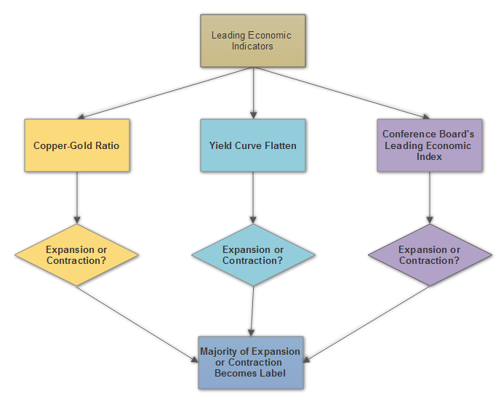
Overview of Project

Slide 8
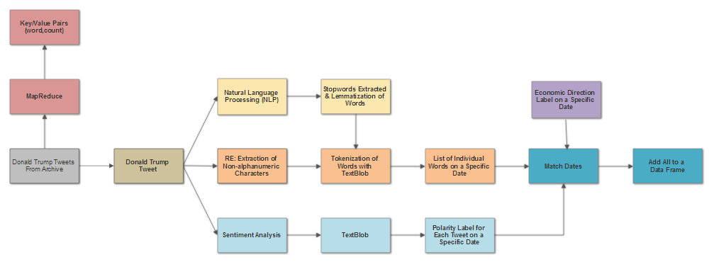
Overview of Project

Slide 9
Methodology: Tweet Cleansing
RE was used to extract the non-alphanumeric characters including emoticons if there were any in a tweet.
Natural Language Toolkit (NLTK) was used to extract stopwords like “a”, “the”, “or”, “of” and to lemmatize any words needing lemmatization in the tweet.
“parsed” and “parses” would lemmatize to “parse”
“softer” and “softly” would lemmatize to “soft”
The clean tweet words are then tokenized into individual words using TextBlob.

Slide 10
Methodology: Sentiment Analysis
TextBlob used for Sentiment Analysis
How Sentiment Analysis is calculated:
(Loria, 2014)
Default sentiment calculations are stored in a en.sentiment.xml file which stores many different “senses” of a particular word.
The word “great” has 4 entries each with different senses. Each entry has a polarity score, subjectivity score, an intensity and a confidence. The polarity and subjectivity scores for the 4 entries are averaged. For “great” polarity = 0.8.
The word “not” is a negative word not handled by TextBlob and automatically gets a score of -0.5
Modifiers like “very” use the intensity score. “very” has an intensity score = 1.3 in its entry in the xml file.
“calculation” and “a” do not have an entry in the xml file so they are ignored.
For polarity, the negation score is multiplied by the inverse of the intensity score of the modifier and the average polarity score.
TextBlob("not a very great calculation").sentiment
>>Sentiment(polarity=-0.3076923076923077, subjectivity=0.5769230769230769)
-0.5*(1/1.3)*0.8 = -0.3076923076923077

Slide 11
Methodology: MapReduce
MapReduce was used on all of the tweets to obtain the frequency of each significant word in the tweet along with its count into Key/Value Pairs.
The Word Count Algorithm was used within a Microsoft Azure Hadoop Spark cluster.
This was useful to do in order to find significant words and phrases that were used frequently in tweets so they can be put together for the analysis.

Slide 12
Experiments/Implementation
Created 4 categories of words and phrases on topics from the time period January 20, 2017 to January 31, 2018
Politics
Healthcare and tax cuts
The Economy
Jobs and “Make America Great Again”
News Media
Fake news and “foxandfriends”
Foreign Affairs
Meetings with people, building the wall, North Korea and Russia

Slide 13
Experiments/Implementation
6 Categories of Sentiment Polarity paired with Economic Direction Label
Python code was used to extract a list of tweets from the archive that contained the words “Hillary” and “FBI”.
Each tweet extracted has the words “Hillary” and “FBI” in it and a date, a sentiment polarity label and economic direction label associated with it all of which are stored in a Panda Series Data Frame.
Using SQL-like statements in Panda Series Data Frame syntax, percentages of each of the categories as shown above were created.
For example, the percentage of tweets with the words “Hillary” and “FBI” that had an Expansion of Economy label and Positive Sentiment label was 30%.
Hillary FBI Sentiment Polarity
 | Positive | Neutral | Negative
Expansion of Economy | 30% | 10% | 20%
Contraction of Economy | 20% | 10% | 10%

Slide 14
Experiments/Implementation
Pie charts were created for each word or phrase experimented with using the percentages for each Sentiment and Economic direction label category.
Words and phrases used:
Politics | The Economy | News Media | Foreign Affairs
tax cut | economy | fake news | hillary fbi
tax cut democrat/dems | make america great | foxandfriends | great meeting
tax cut republican | people job/working | realdontrump | north korea
healthcare/ obamacare |  |  | russia/russian collusion
 |  |  | wall

Slide 15
Results
The time period from January 2017 to January 2018 was an economic period where the economy grew more than it contracted.
If all of the pie charts were divided by the economic direction label of expansion and contraction, it was easy to see that approximately 80% of the pie fell into the expansion category and approximately 20% in the contraction category.
More precisely, just using the economic direction tags for every tweet, it was found that 81.0% were expansion of the economy tags and 19.0% were contraction of the economy.
To make the results more significantly meaningful, focus on salient features from the pie charts in the areas where a result showed a significant portion of the pie where there was contraction in the economy.
Sentiment was negative yet there was expansion in the economy for a specific set of tweets (pink slices in pie)
Sentiment was positive yet there was contraction in the economy for a specific set of tweets. (indigo blue slices in pie)

Slide 16
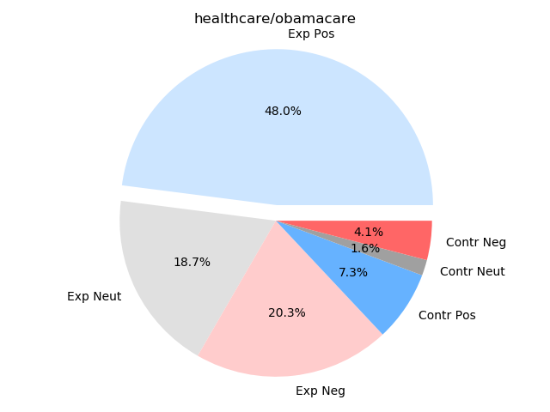
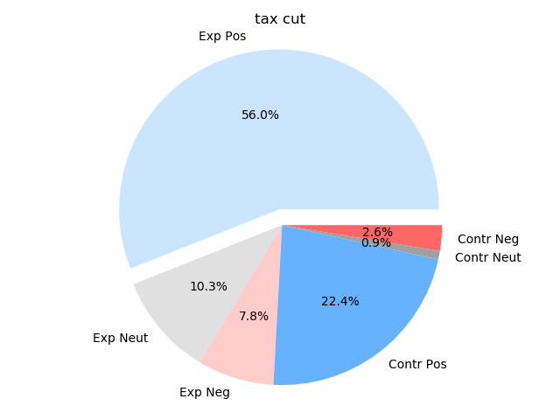
Results: Politics
20.3% of tweets had negative sentiment on a day when the economy expanded when the subject of the tweet was healthcare.
22.4% of the tweets had positive sentiment on a day when the economy contracted when the subject of the tweet was about the Tax Cut Bill.

Slide 17
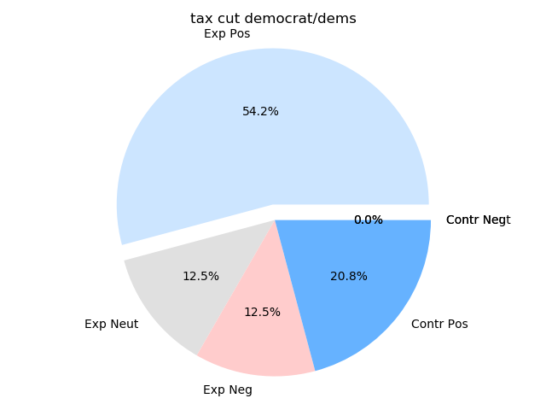
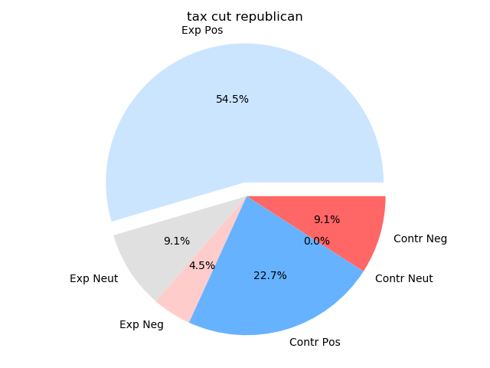
Results: Politics
Differences between having the word democrat verse republican were not significant except when there was negative sentiment and contraction in the economy on a specific day.
This 9.1% slice in red is when the word republican was in the tweet and there was negative sentiment and contraction in the economy. The word “hard” appears in all of these tweets.

Slide 18
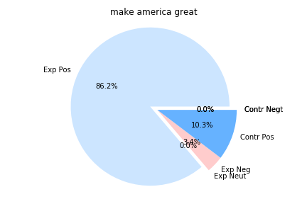
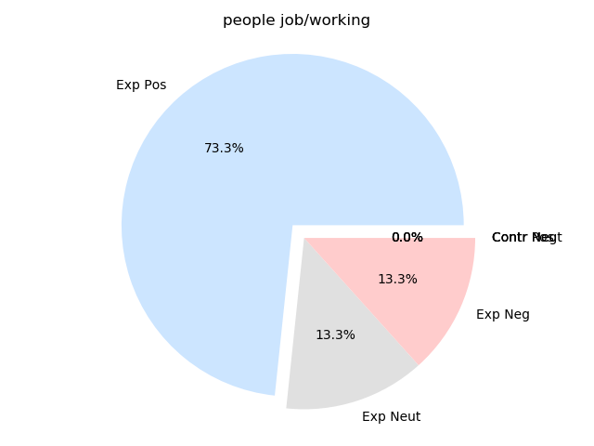
Results: The Economy
“Make America great”, a very positive slogan, showed 86.2% of the pie with positive sentiment and expansion of the economy.
There is no contraction in the economy whenever jobs and people working were the topic of the tweet.

Slide 19
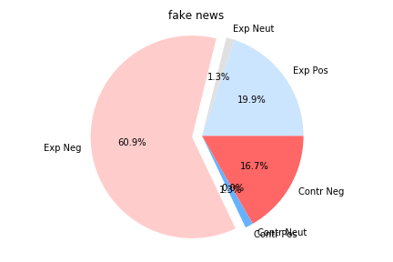
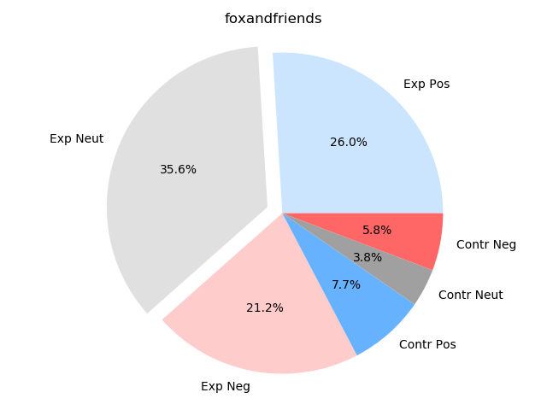
Results: News Media
Here the word “fake” creates a lot of negative sentiment in the tweet.
The word “foxandfriends” shows 82.8% of the chart under expansion in the economy.

Slide 20
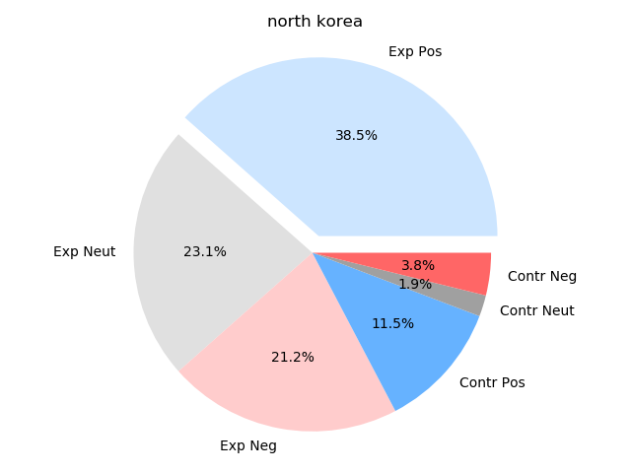
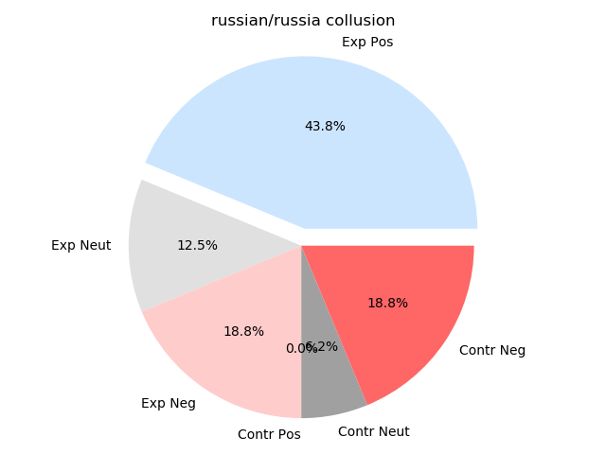
Results: Foreign Affairs
The topic of North Korea created more expansion in the economy than contraction.
The topic of the Russian probe within the time period of this project appears to be insignificant.

Slide 21
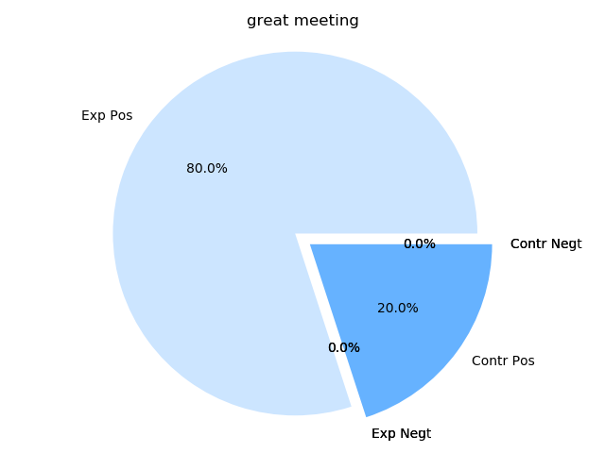
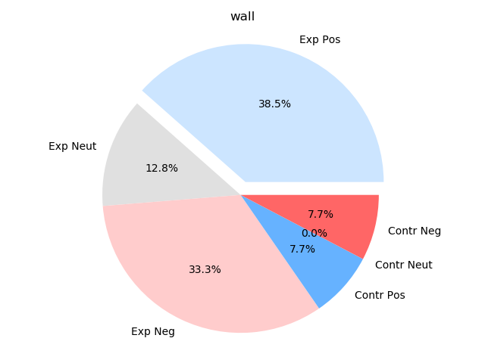
Results: Foreign Affairs
Another example of the word “great” having 100% positive sentiment.
Here the topic of the wall shows 84.6% of the pie in expansion of economy category.

Slide 22
Discussion of Results
Two salient features stood out in the results
Mainly positive sentiment and expansion of the economy in most of the pie charts.
The time period the tweets were evaluated showed more expansion in the economy than contraction.
It would be nice to see periods in the economic data where there is a lot more contraction in the economy or more equal amounts of expansion and contraction to see how Donald Trump’s tweets influence such a distribution.
How the sentiment analysis calculation determined the polarity of the tweet.
TextBlob Sentiment Analysis was not sophisticated enough in differentiating the positive and negative meanings of the word “hard” because it did not evaluate the words before and after it.
The word “hard” has a negative connotation when compared to “soft” but when it is used in the phrase “hard working” like it is in the tweet, it supposedly becomes somewhat positive in nature.
We would need a machine learning algorithm that had a large enough training set to differentiate these meanings. This is something that could definitely be improved upon in future development of sentiment analysis.

Slide 23
Conclusion
The purpose of this project was to see how the sentiment of Donald Trump tweets and the words or phrases he uses in them correlate to a daily expansion or contraction in the United States economy.
Based on the above results that cover the period from January 20, 2017 to January 31, 2018, the economy did quite well at expanding in this period and Donald Trump could arguably take some credit for the expansion of the economy.
Because the data is highly skewed towards economic expansion, no real conclusions about the predictability can be made until data showing significant contraction in the economy is seen to have similar effects.
It can be concluded based on the results of this project that tweets produced by a powerful person like the President of the United States could possibly be used to predict future expansion or contraction in the economy, but more data that reflects a contracting economy needs to be investigated before making a definitive conclusion.

Slide 24
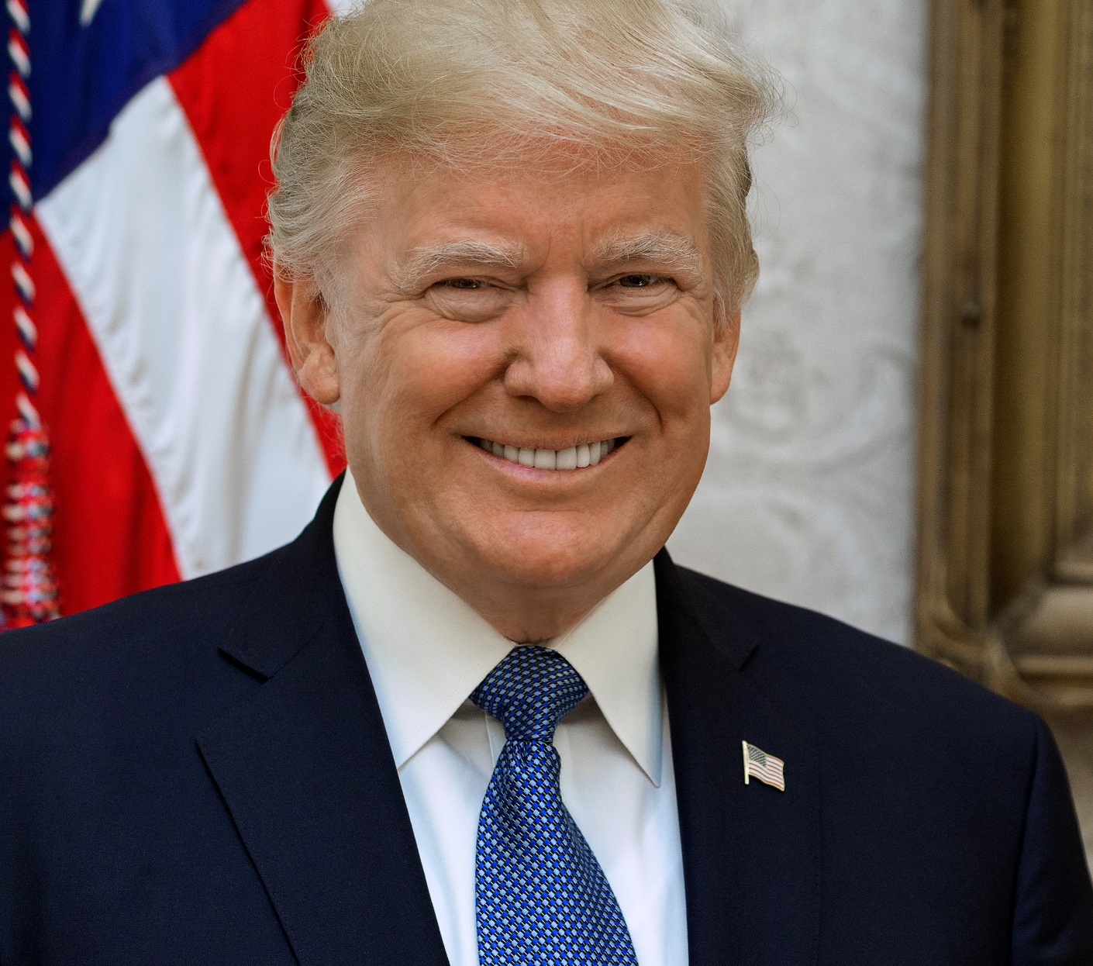
Any Questions?
Thank
You!

